Slide 1

Entrepreneurship: Successfully Launching New Ventures
Sixth Edition
Chapter 4
Developing an Effective Business Model
Notes:
If this PowerPoint presentation contains mathematical equations, you may need to check that your computer has the following installed:
1) MathType Plugin
2) Math Player (free versions available)
3) NVDA Reader (free versions available)

Slide 2
Learning Objectives
4.1 Describe business models and discuss their importance.
4.2 Identify and describe the two general types of business models—standard and disruptive.
4.3 Explain the components of the Barringer/Ireland Business Model Template that entrepreneurs can use to develop a business model for their firm.

Slide 3
Business Models
Business Model
A business model is a firm’s plan or recipe for how it creates, delivers, and captures value for its stakeholders.
The proper time to develop a business model is following the feasibility analysis stage and prior to fleshing out the operational details of the company.
A firm’s business model is integral to its ability to succeed both in the short and long term.

Slide 4
General Categories of Business Models (1 of 5)
Standard Business Models
The first category is standard business models.
Standard business models depict existing plans or recipes firms can use to determine how they will create, deliver, and capture value.
There are a number of standard or common business models, which are shown on the next two slides.

Slide 5
General Categories of Business Models (2 of 5)
Standard Business Models
Business Model | Representative Companies
Advertising Business Model | Google, Facebook
Auction Business Model | eBay, uBid
Bricks and Clicks Business Model | Apple, Barnes & Noble
Franchise Business Model | 24 Hour Fitness, Panera Bread
Freemium Business Model | Dropbox, Evernote
Low-Cost Business Model | Southwest Airlines, Warby Parker
Manufacturer/Retailer Business Model | Apple, Fitbit, Tesla Motors
Peer-to-Peer Business Model | Airbnb, Uber

Slide 6
General Categories of Business Models (3 of 5)
Standard Business Models
Business Model | Representative Companies
Razor and Blades Business Model | Game Consoles and Games, Printers and Ink Cartridges
Subscription Business Model | Birchbox, Blue Apron, Netflix
Traditional Retailer Business Model | Whole Foods Markets, Zappos

Slide 7
General Categories of Business Models (4 of 5)
Disruptive Business Models
The second category is disruptive business models.
Disruptive business models, which are rare, are ones that do not fit the profile of a standard business model.
They are impactful enough that they disrupt or change the way business is conducted in an industry or an important niche within an industry.
The next slides depict four business models that were disruptive when they were introduced.

Slide 8
General Categories of Business Models (5 of 5)
Disruptive Business Models
Business Model | Company or Companies That Introduced It
Direct-to-Consumer Computer Sales (which allowed consumers to customize their computers) | Dell
Online Text Ads on Search Engines (allowed advertisers to place ads for products that searchers were already searching for) | Yahoo, Google
Software as a Service (SaaS) (By moving software to the cloud, allowed users to access the software and their data from anywhere there was an Internet connection) | Salesforce.com
Cloud-based Service to Connect Riders and People Willing to Provide Rides (Provided riders with an app that connects them with the owners of private cars) | Uber, Lyft

Slide 9
Barringer/Ireland Business Model Template (1 of 2)
Barringer/Ireland Business Model Template
Although not everyone agrees precisely on the components of a business model, many agree that a successful business model has a common set of attributes.
These attributes can be laid out in a visual framework or template so it is easy to see the individual parts and their interrelationships.
The Barringer/Ireland Business Model Template is shown in the next slide.

Slide 10
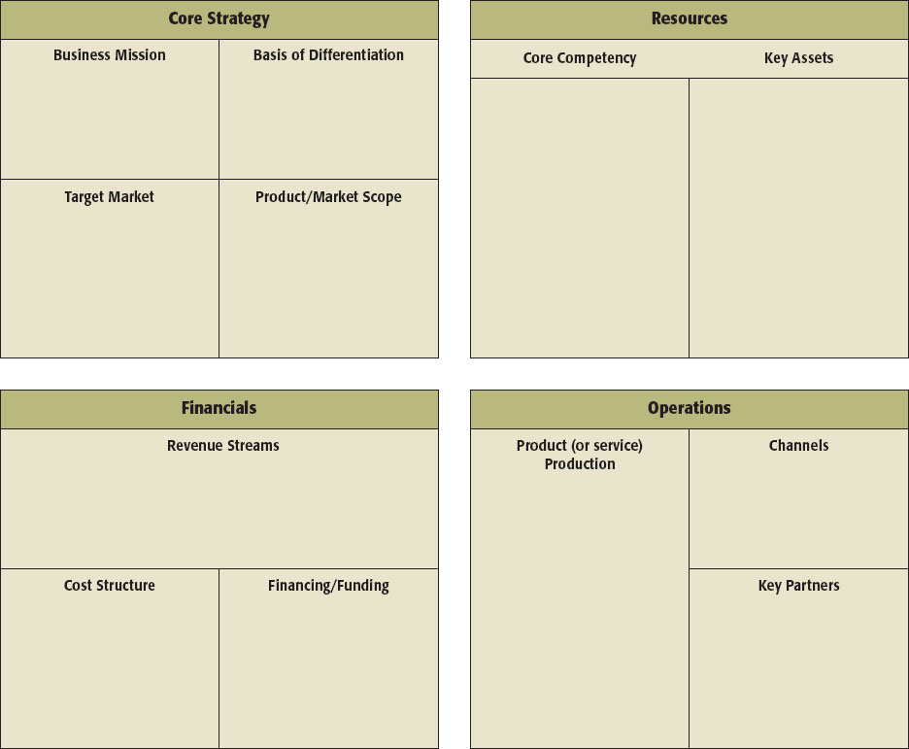
Barringer/Ireland Business Model Template (2 of 2)
Figure 4.2 Barringer/Ireland Business Model Template

Slide 11
Core Strategy (1 of 5)
Core Strategy
The first component of the business model is core strategy.
A core strategy describes how the firm plans to compete relative to its competitors.
The primary elements of core strategy are:
Business Mission
Basis of Differentiation
Target Market
Product/Market Scope

Slide 12
Core Strategy (2 of 5)
Business Mission
A business’s mission or mission statement describes why it exists and what its business model is supposed to accomplish.
If carefully written and used properly, a mission statement can articulate a business’s overarching priorities and act as its financial and moral compass.
A well-written mission statement is something that a business can continually refer back to as it makes important decisions in other elements of its business model.

Slide 13
Core Strategy (3 of 5)
Basis of Differentiation
It’s important that a business clearly articulate the points that differentiate its product or service from competitors.
A company’s basis of differentiation is what causes consumers to pick one company’s products over another’s.
It is what solves a problem or satisfies a customer need.
It is best to limit a company’s basis of differentiation to two to three key points.
Make sure that your points of differentiation refer to benefits rather than features.

Slide 14
Core Strategy (4 of 5)
Target Market
The identification of the target market in which the firm will compete is extremely important.
A target market is a place within a larger market segment that represents a narrow group of customers with similar interests.
A firm’s target market should be made explicit in the business model template.

Slide 15
Core Strategy (5 of 5)
Product/Market Scope
A company’s product/market scope defines the products and markets on which it will concentrate.
Most firms start with a narrow (or limited) product/market scope, and pursue adjacent product and market opportunities as the company grows and becomes more financially secure.
In completing the business model template, a company should be very clear about its initial product/market scope and project 3-5 years in the future in terms of anticipated expansion.

Slide 16
Resources (1 of 3)
Resources
The second component of a business model is resources.
Resources are the inputs a firm uses to produce, sell, distribute, and service a product or service.
A firm’s most important resources, both tangible and intangible, must be both difficult to imitate and hard to find a substitute for.
This stipulation is necessary for an individual company’s business model to be competitive over the long term.

Slide 17
Resources (2 of 3)
Core Competencies
A core competency is a specific factor or capability that supports a firm’s business model and sets it apart from rivals.
A core competency can take on various forms, such as technical know-how, an efficient process, a trusting relationship with customers, expertise in product design, and so forth.
Most start-ups will list two to three core competencies in their business model template.

Slide 18
Resources (3 of 3)
Key Assets
Key assets are the assets that a firm owns that enable its business model to work. The assets can be physical, financial, intellectual, or human.
Physical assets include physical space, equipment, vehicles, and distribution networks.
Intellectual assets include resources such as patents, trademarks, copyrights, and trade secrets, along with a company’s brand and its reputation.
Financial assets include cash, lines of credit, and commitments from investors.
Human assets include a company’s founder or founders, its key employees, and its advisors.

Slide 19
Financials (1 of 5)
Financials
The third component of a firm’s business model focuses on its financials.
This is the only section of a firm’s business model that describes how it earns money—thus, it is extremely important.
For most businesses, the manner in which it makes money is one of the most fundamental aspects of its business model.

Slide 20
Financials (2 of 5)
Revenue Streams
A firm’s revenue streams describe the ways in which it makes money.
Some businesses have a single revenue stream while others have several.
For example, most restaurants have a single revenue stream. Their customers order a meal and pay for it. Other restaurants may have several revenue streams—including meals, a catering service, product sales (such as bottled barbeque sauce for a barbeque restaurant), and apparel products with the name of the restaurant on them.

Slide 21
Financials (3 of 5)
Cost Structure
A business’s cost structure describes the most important costs incurred to support its business model.
It costs money to establish a basis of differentiation, develop core competencies, acquire and develop key assets, and so forth.
Generally, the goal for this box in a firm’s business model template is threefold:
Identify whether the business is a cost-driven or value-driven business.
Identify the nature of the business’s costs.
Identify the business’s major cost categories.

Slide 22
Financials (4 of 5)
Financing/Funding
Many business models rely on a certain amount of financing or funding to bring their business model to life.
At the business model stage projections do not need to be completed to determine the exact amount of money that is needed. An approximation is sufficient.
There are three categories of costs to consider:
Capital costs.
One-time expenses, such as building a Web site and training initial employees.
Provisions for ramp-up expenses (most businesses incur costs before they earn revenues).

Slide 23
Financials (5 of 5)
Financing/Funding (continued)
Some entrepreneurs are able to draw from personal resources to fund their business. In other cases, the business may be simple enough that it is funded from its own profits from day one.
In many cases, however, an initial infusion of funding or financing is needed.
The business model template should indicate the appropriate amount of funding that will be needed and where the money will most likely come from.

Slide 24
Operations (1 of 5)
Operations
The final quadrant in a firm’s business model focuses on operations.
Operations are both integral to a firm’s overall business model and represent the day-to-day heartbeat of a firm.

Slide 25
Operations (2 of 5)
Product (or Service) Production
This section focuses on how a firm’s products and/or services are produced.
For example, if a firm sells a physical product, the product can be manufactured or produced in-house, by a contract manufacturer, or via an outsource provider.
This decision has a major impact on all aspects of a firm’s business model.
If a firm is producing a service rather than a physical product, a brief description of how the service will be produced should be provided.

Slide 26
Operations (3 of 5)
Channels
A company’s channels describe how it delivers its product or service to its customers.
Businesses either sell direct, through intermediaries (such as distributors and wholesalers), or via a combination of both.
Some firms employ a sales force that calls on potential customers to try to close sales. This is an expensive strategy but necessary in some instances.

Slide 27
Operations (4 of 5)
Key Partners
The final element of a firm’s business model is key partners.
Start-ups, in particular, typically do not have sufficient resources (or funding) to perform all the tasks necessary to make their business models work, so they rely on key partners to perform important roles.
The table on the next slide identifies the most common types of business partnerships.

Slide 28
Operations (5 of 5)
Table 4.4 The Most Common Types of Business Partnerships
Partnership Form | Description
Joint venture | An entity created by two or more firms pooling a portion of their resources to create a separate, jointly-owned organization
Network | A hub-and-wheel configuration with a local firm at the hub organizing the interdependencies of a complex array of firms
Consortia | A group of organizations with similar needs that band together to create a new entity to address those needs
Strategic alliance | An arrangement between two or more firms that establishes an exchange relationship but has no joint ownership involved
Trade associations | Organizations (typically nonprofit) that are formed by firms in the same industry to collect and disseminate trade information, offer legal and technical advice, furnish industry-related training, and provide a platform for collective lobbying
Source: B. Barringer and J. S. Harrison, “Walking a Tightrope: Creating Value Through Interorganizational Relationships,” Journal of Management 26, no. 3 (2000): 367–403.

Slide 29

Copyright

